Slide 1
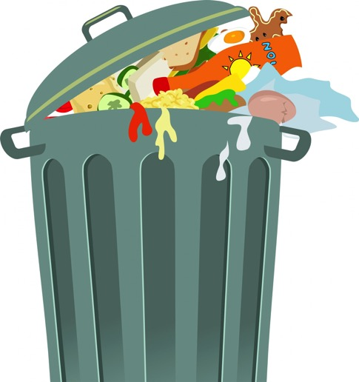
Investigating waste as an energy source

Slide 2
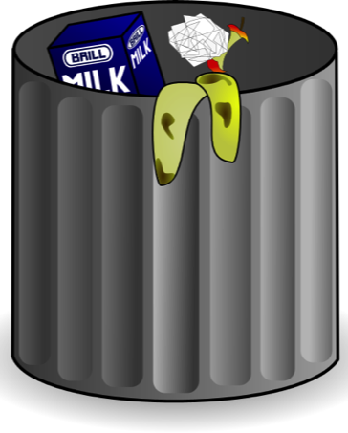
Think about the amount of rubbish your class makes every day.
What kind of things are in your bin?

Slide 3
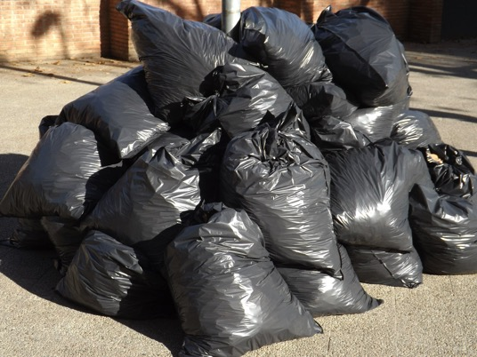
Some places around the world view waste not as rubbish to go into a landfill, but as a valuable resource.
All types of waste, such as household and industrial waste, are being processed in a range of ways to generate electricity. They are generally processed in places called waste to energy facilities.

Slide 4
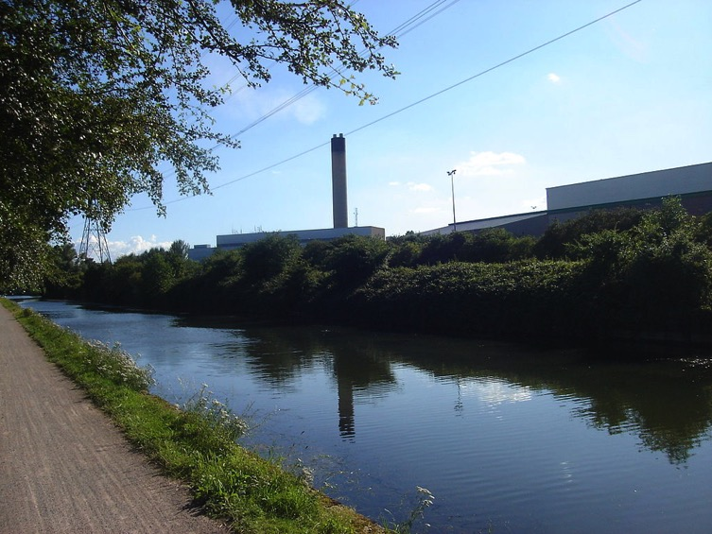
Waste to energy facilities are opening up around Australia and around the world. They are environmentally friendly and are using a sustainable resource (waste) instead of fossil fuels to generate electricity and heating.
LondonWaste EcoPark Energy Centre

Slide 5
There are different types of waste to energy facilities in Australia. A couple of methods used to generate electricity are:
Low temperature gasification technology — Waste is converted into a synthetic gas and then fired to produce heat energy. The heat energy is then used to produce steam.
Thermal heat — Household and industrial waste are burned in a specially designed machine to produce heat energy. The heat energy is then used to produce steam.
How could electricity
be generated now?

Slide 6
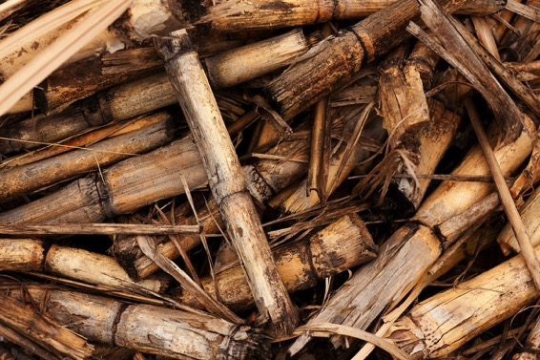
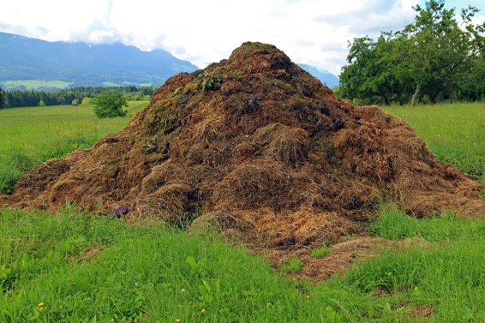
Some of the types of waste currently being used as energy sources to generate electricity are:
crop waste
livestock manure
wood scraps
paper production waste (black liquor)
food scraps
sewage.

Slide 7
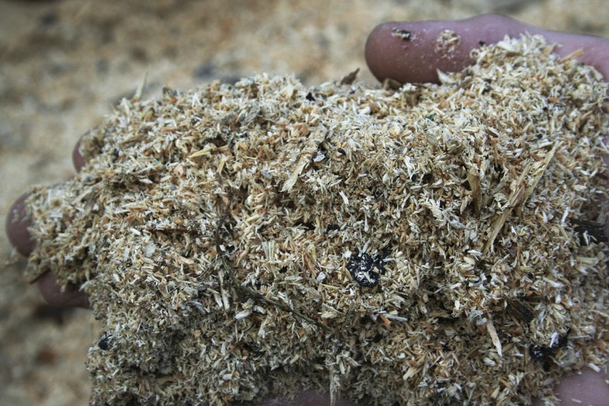
These types of waste are also called biowaste. Biowaste is organic waste products from industries that can be used as an energy source.
Bioenergy is the renewable energy that can be extracted from biowaste.
Wood scraps is a type of biowaste. It is also a source of bioenergy.

Slide 8
Attribution slide:
Slide 1: http://pixabay.com/en/trash-can-trash-can-rubbish-bin-313711/
Slide 2: https://openclipart.org/detail/27074/trash-can
Slide 3: http://pixabay.com/en/garbage-bags-waste-plastic-413757/
Slide 4: http://commons.wikimedia.org/wiki/File:Edmonton_Incinerator_DSC00571.jpg
Slide 6: http://pixabay.com/en/background-biomass-crop-cut-70997/
http://pixabay.com/en/dung-compost-heap-rallying-point-406217/
Slide 7: http://pixabay.com/en/sawdust-the-hand-wood-shavings-547506/

